Slide 1

Attendance Management using Face Recognition
making the attendance tracking system in colleges more efficient

Slide 2
The PROBLEM & SOLUTION PROPOSED
THE PROBLEM
Recording attendance for a lecture , although a secondary task during the lecture, holds extreme administrative importance for any educational system
The manual pen and paper recording of attendance is time consuming and wastes important lecture time, gets more tedious for a large class(50+ students)
Difficult to verify and correct any wrong attendance entry
Difficult to identify if unauthorised students enter a large class
SOLUTION
Automate the process of recording attendance by identifying students present in class through automatic facial detection and recognition
Define a workflow around the process of recording attendance, giving rights to the faculty to manage the automated attendance record, generate reports, triggers and notifications on important dates.

Slide 3
SYSTEM REQUIREMENTS
Objective :
To build a system for managing the process of recording attendance and generating reports giving relevant stakeholder-ship to College admin, Faculty and Students
Key Design Considerations :
The system should be a one stop system for all information related to the attendance for a course
The Admin and the faculty should be able to upload class attendance picture – the facial detection system to recognise the students present in the class
The faculty should be able to see the report and change the attendance record in case of any discrepancy. The faculty should see the statistics around the number of classes done, attendance percentage etc.
The students should be able to view their attendance records for different courses

Slide 4
TECHNOLOGY STACK
System built on Django (version 3.0.5)- MVT
Database : SQLite
UI : HTML/CSS using Bootstrap
Face Detection API

Slide 5

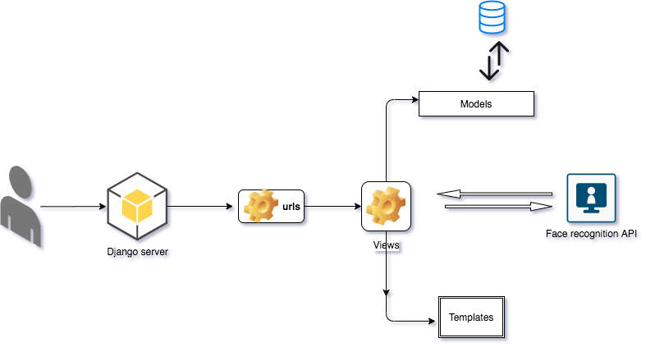
System Architecture overview

Slide 6
High level Code structure
Views
Attendence
Class
Class details
Models
User
Dept
Course
Class
Student
Teacher
Assign
Attendance
Templates
Login/Logout
Attendance/Attendance details
Attendance_detail
Students
Class Dates
Cancel class
Class/class details
Auto attendance
Upload class image
Students

Slide 7
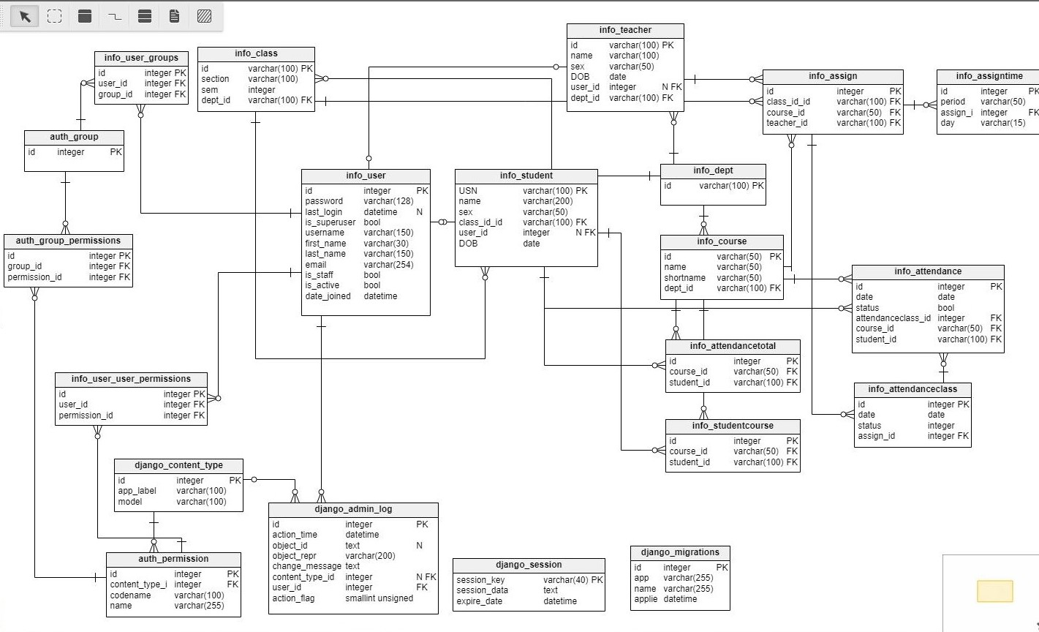
DataBASE SCHEMA

Slide 8

DESIGN
Design Choices:
Programming Paradigm : Object Oriented (Django default)
Design Pattern : Model – View – Template (Django default) , Separation of concerns
Good Practices:
Adherence to SOLID principles:
Single Responsibility : A model –view – template combination manages one logical flow only
Open-Close-Principle – Very few derived objects used
Liskov Substitution – Not many class-subclass hierarchy defined
Interface Segregation- The MVT pipeline is an independent logical entity and does not depend on others
Dependancy Inversion – Models abstract the schema and the entity relationships.

Slide 9
Design : Good Practices
Application Flexibility :
All of application modules are loosely coupled.
Any added functionality(for e.g. – Recording and managing Marks for students in a course) can be incorporated without affecting any of the existing functionality
Reduce Complexity:
Complexity is significantly reduced with the MVC pattern that divides the task components into three i.e. model, view and controller.
Every logical concern is addressed by a separate unit – either of M,V or C

Slide 10
Logical System components
Admin
Admin to add Departments, Courses, Classes, Student, Faculty to the semester
Admin to define the roles and authorization level for all the users- Staff and non staff
Teacher
To the courses added to the faculty’s profile, he can upload class picture to generate attendance report.
See the report for a course, student adherence of percentage attendance norms
Student
Face detection API trained with the image of all enrolled students
When the class image is uploaded, a call to the API is made, the API identifies the students present in the class based on registered students for a course, returns the annotated image of the class and the roll numbers and names of the students identified.
Facial Detection
Students see the courses they are enrolled in
Can choose faculty for a course and students enrolled in the course
Can edit attendance, cancel class
They see the attendance record for a particular course
The percentage of presence in a particular course

Slide 11
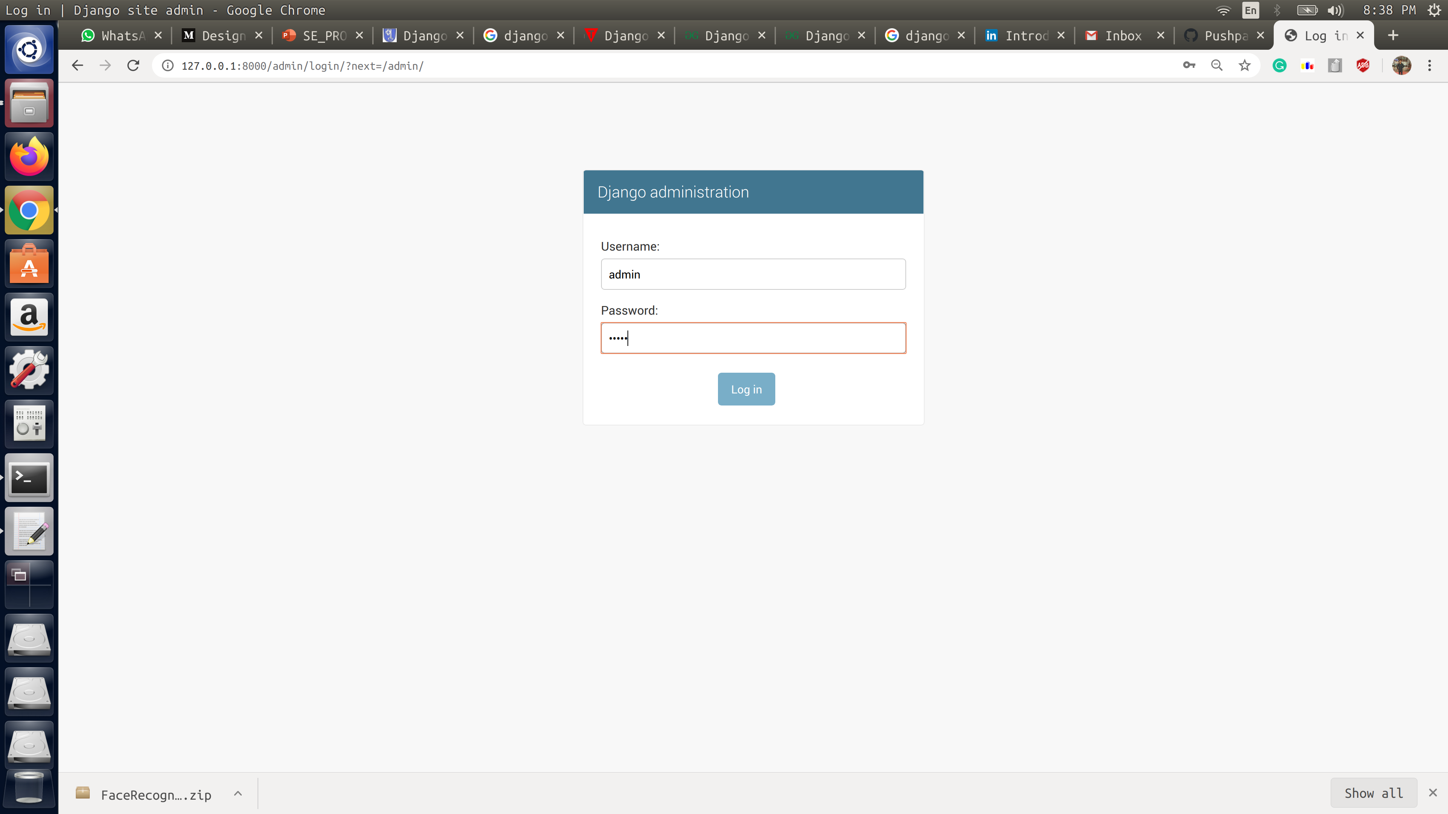
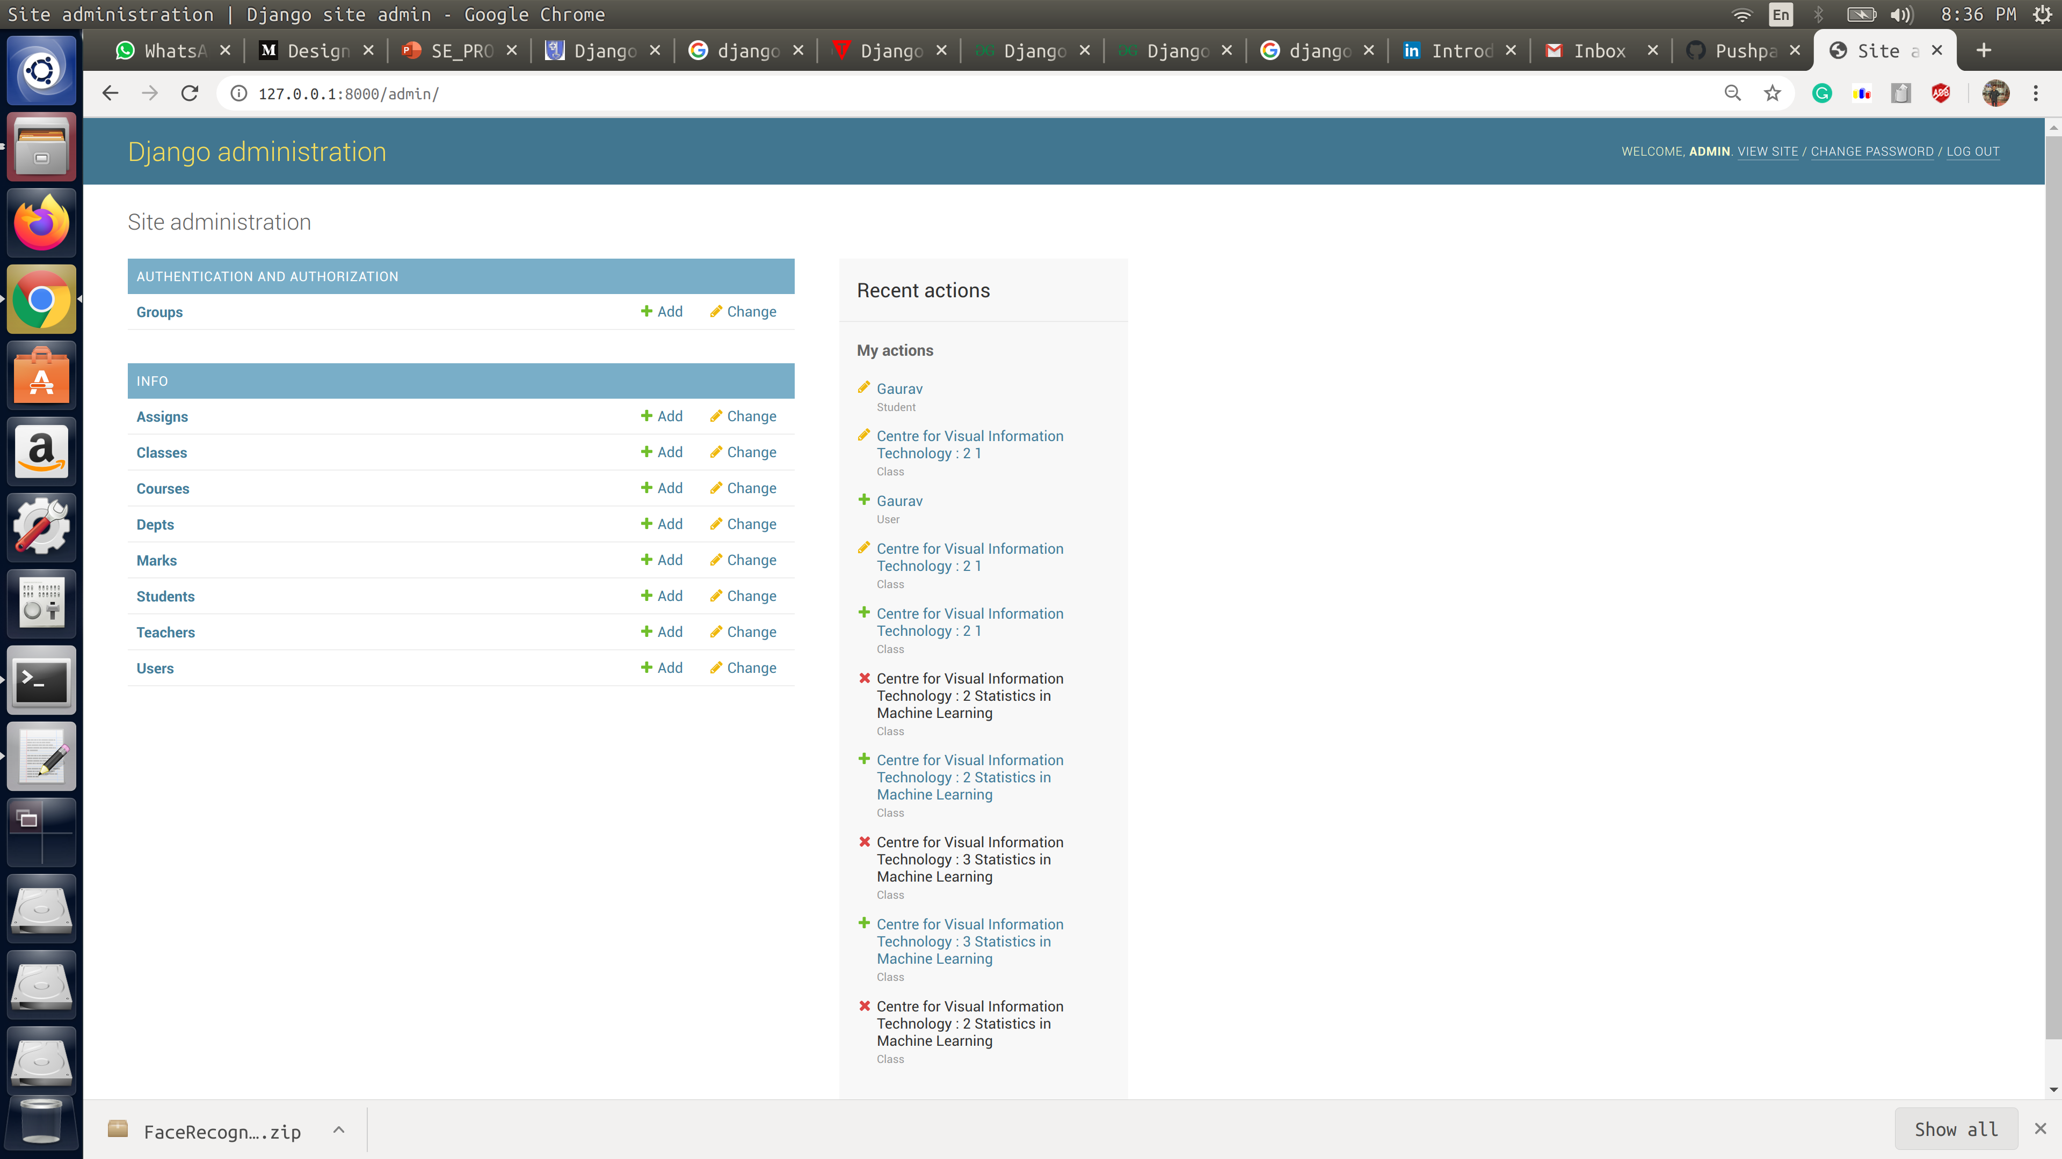
APPLICATION DETAILS – CONFIGURE SEMESTER DETAILS : LOGIN AS ADMIN

Slide 12
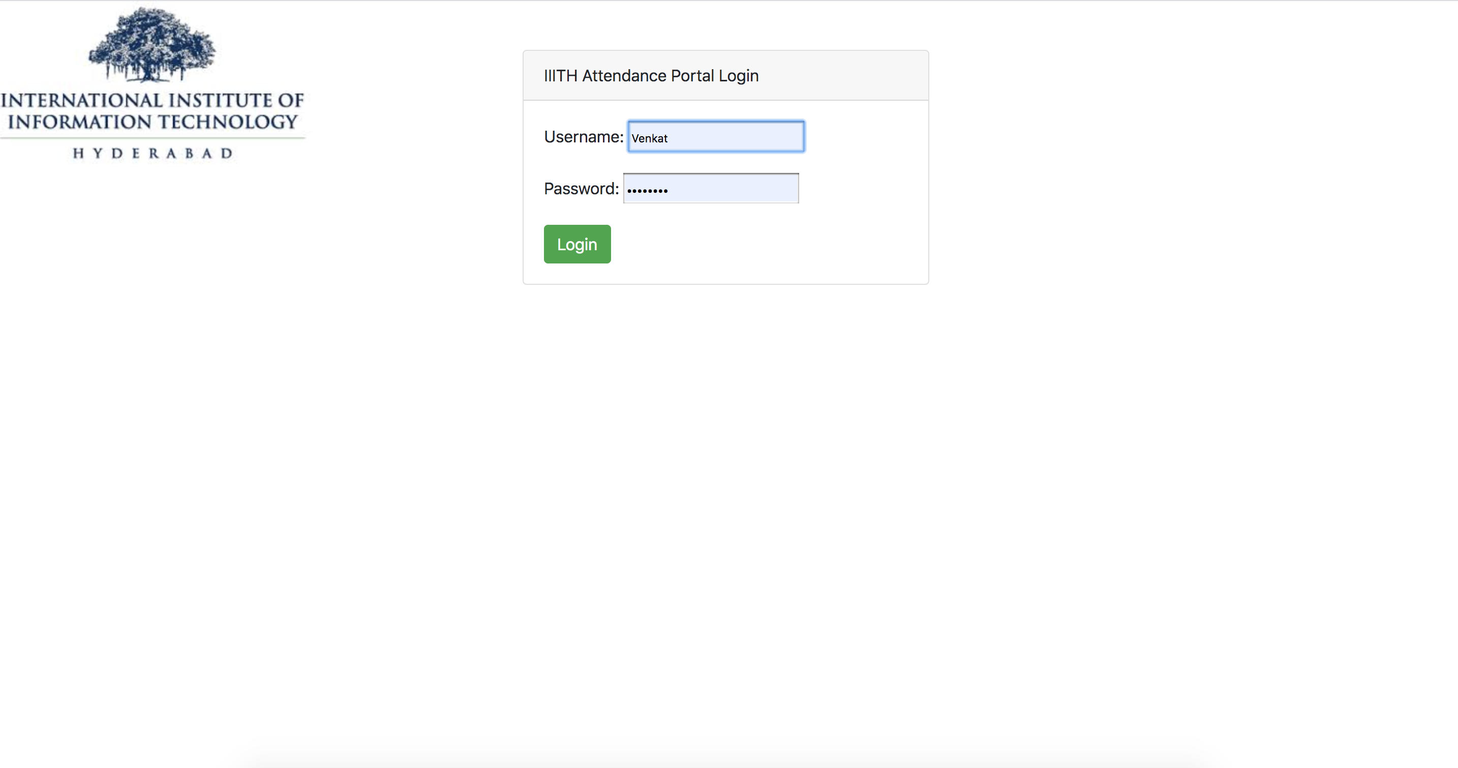
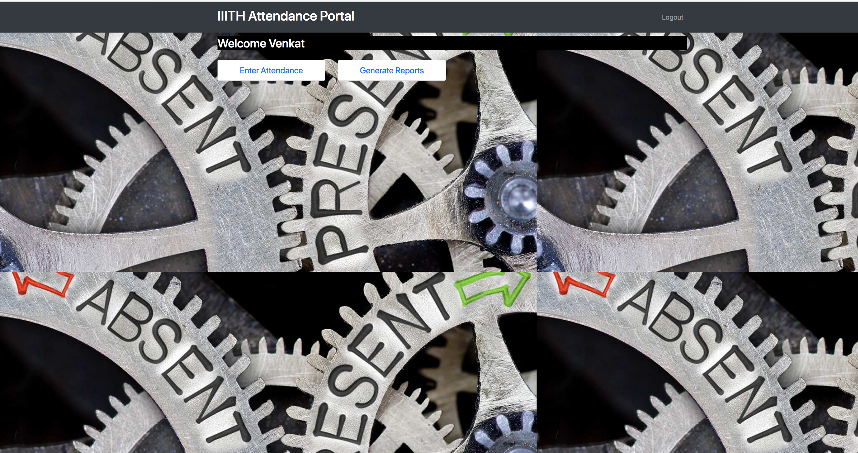
APPLICATION DETAILS – LoGIN AS A FACULTY

Slide 13
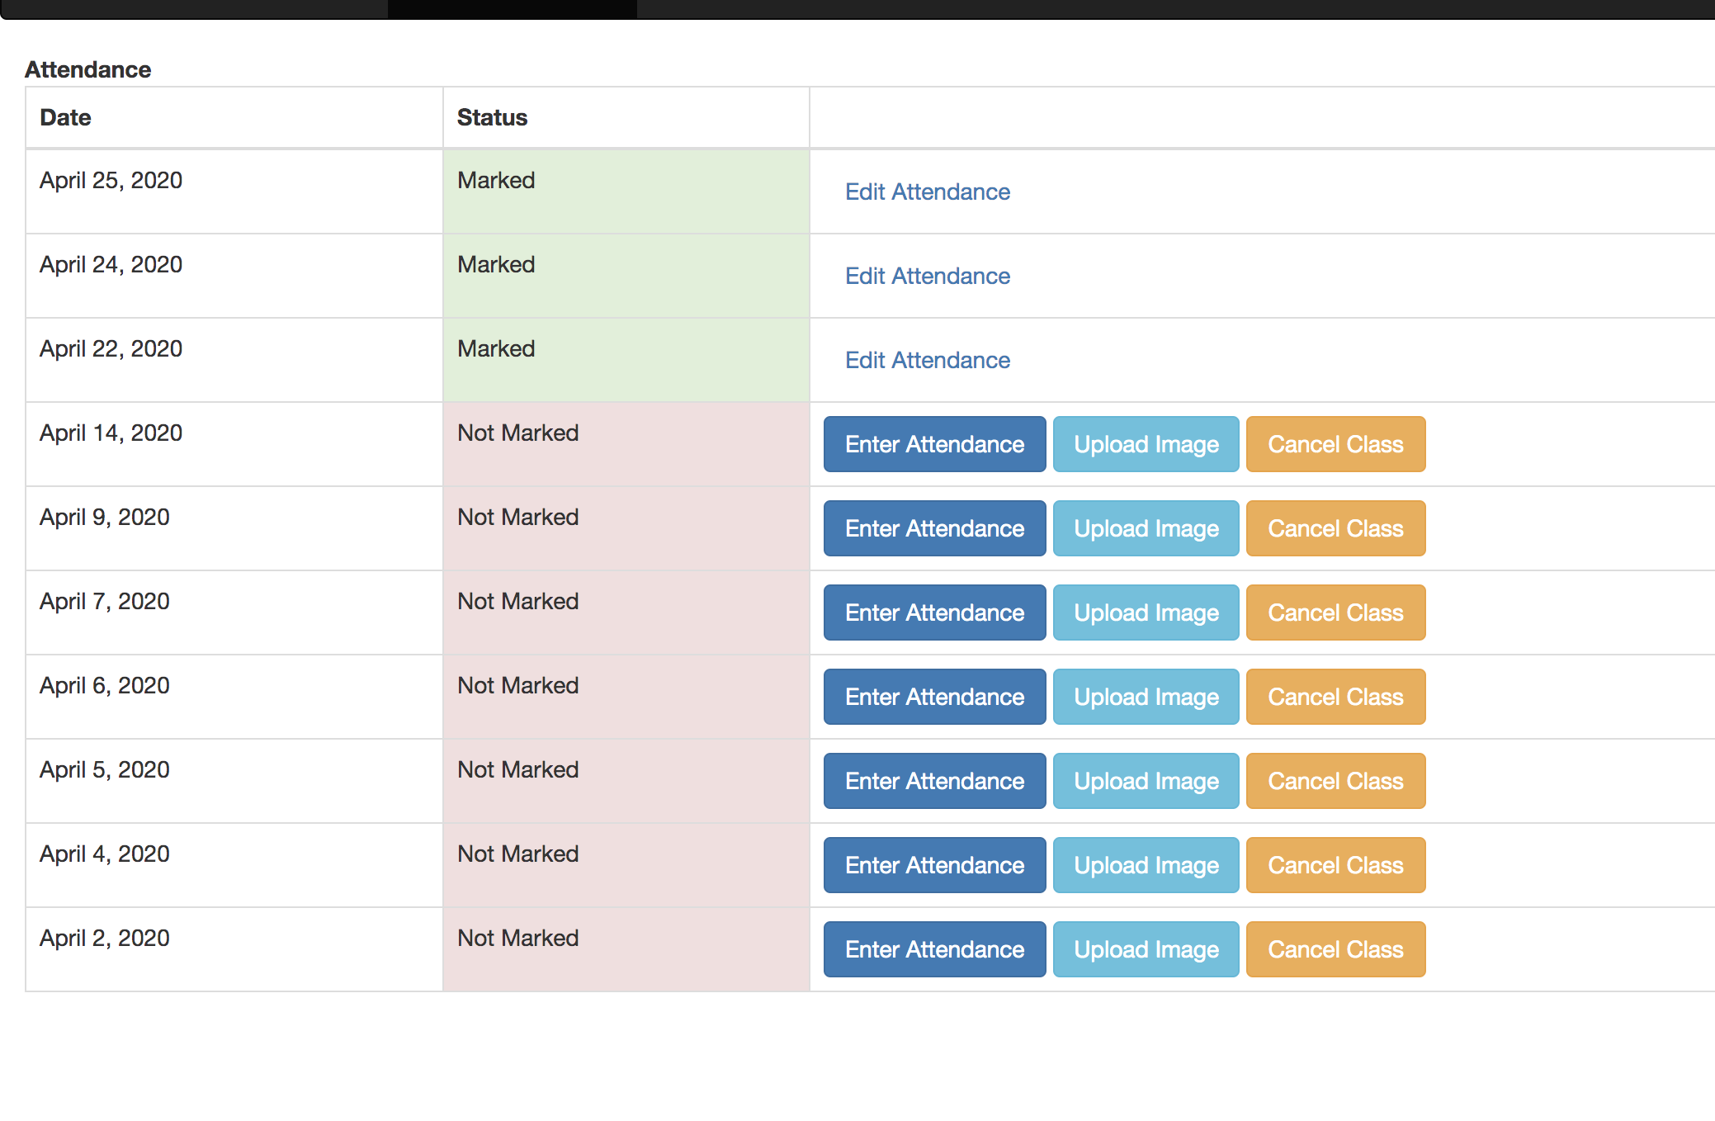
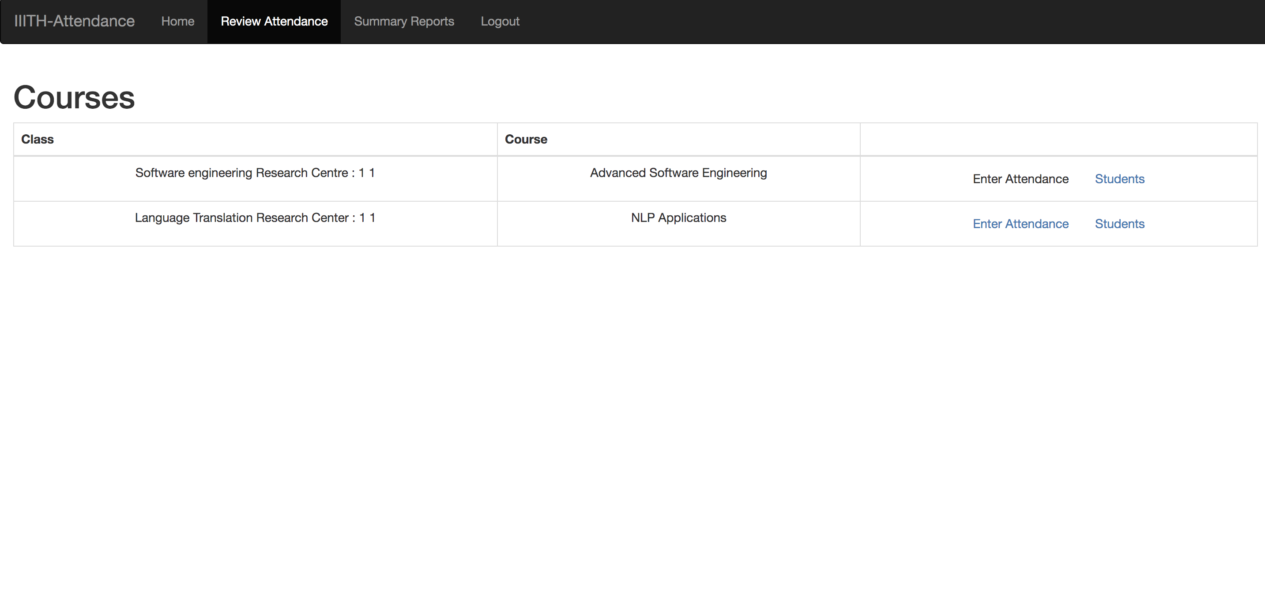
APPLICATION DETAILS – SELECT Course TO VIEW ATTENDANCE RECORDS

Slide 14
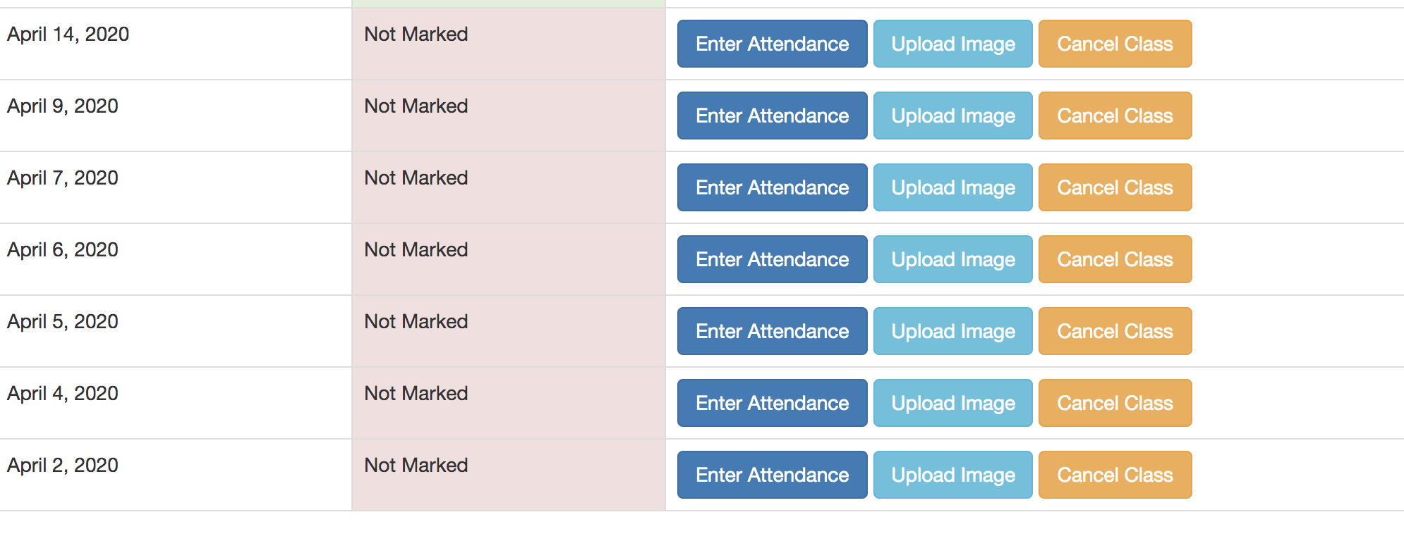
APPLICATION DETAILS : RECORD ATTENDANCE FOR A LECTURE BASED ON THE DAY

Slide 15
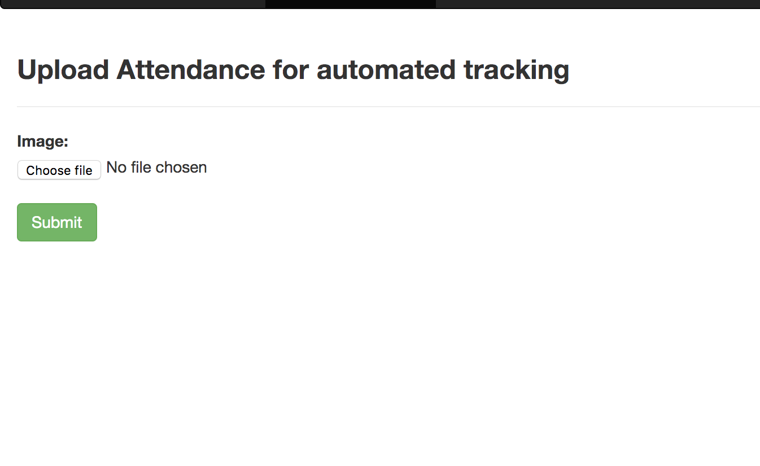
APPLICATION DETAILS: UPLOAD CLASS PHOTO to generate ATTENDANCE REPORT

Slide 16
URL BEING HIT FROM APPLICATION TO TRIGGER FACE RECOGNITION AND GETTING RESPONSE BACK AFTER DETECTING THE IMAGE
http://2fb02c4a.ngrok.io/ : URL is hosted in public domain with the help of ngrok command .
Face Detection module and Django server are completely independent ,they can be hosted on different server to balance load

Slide 17
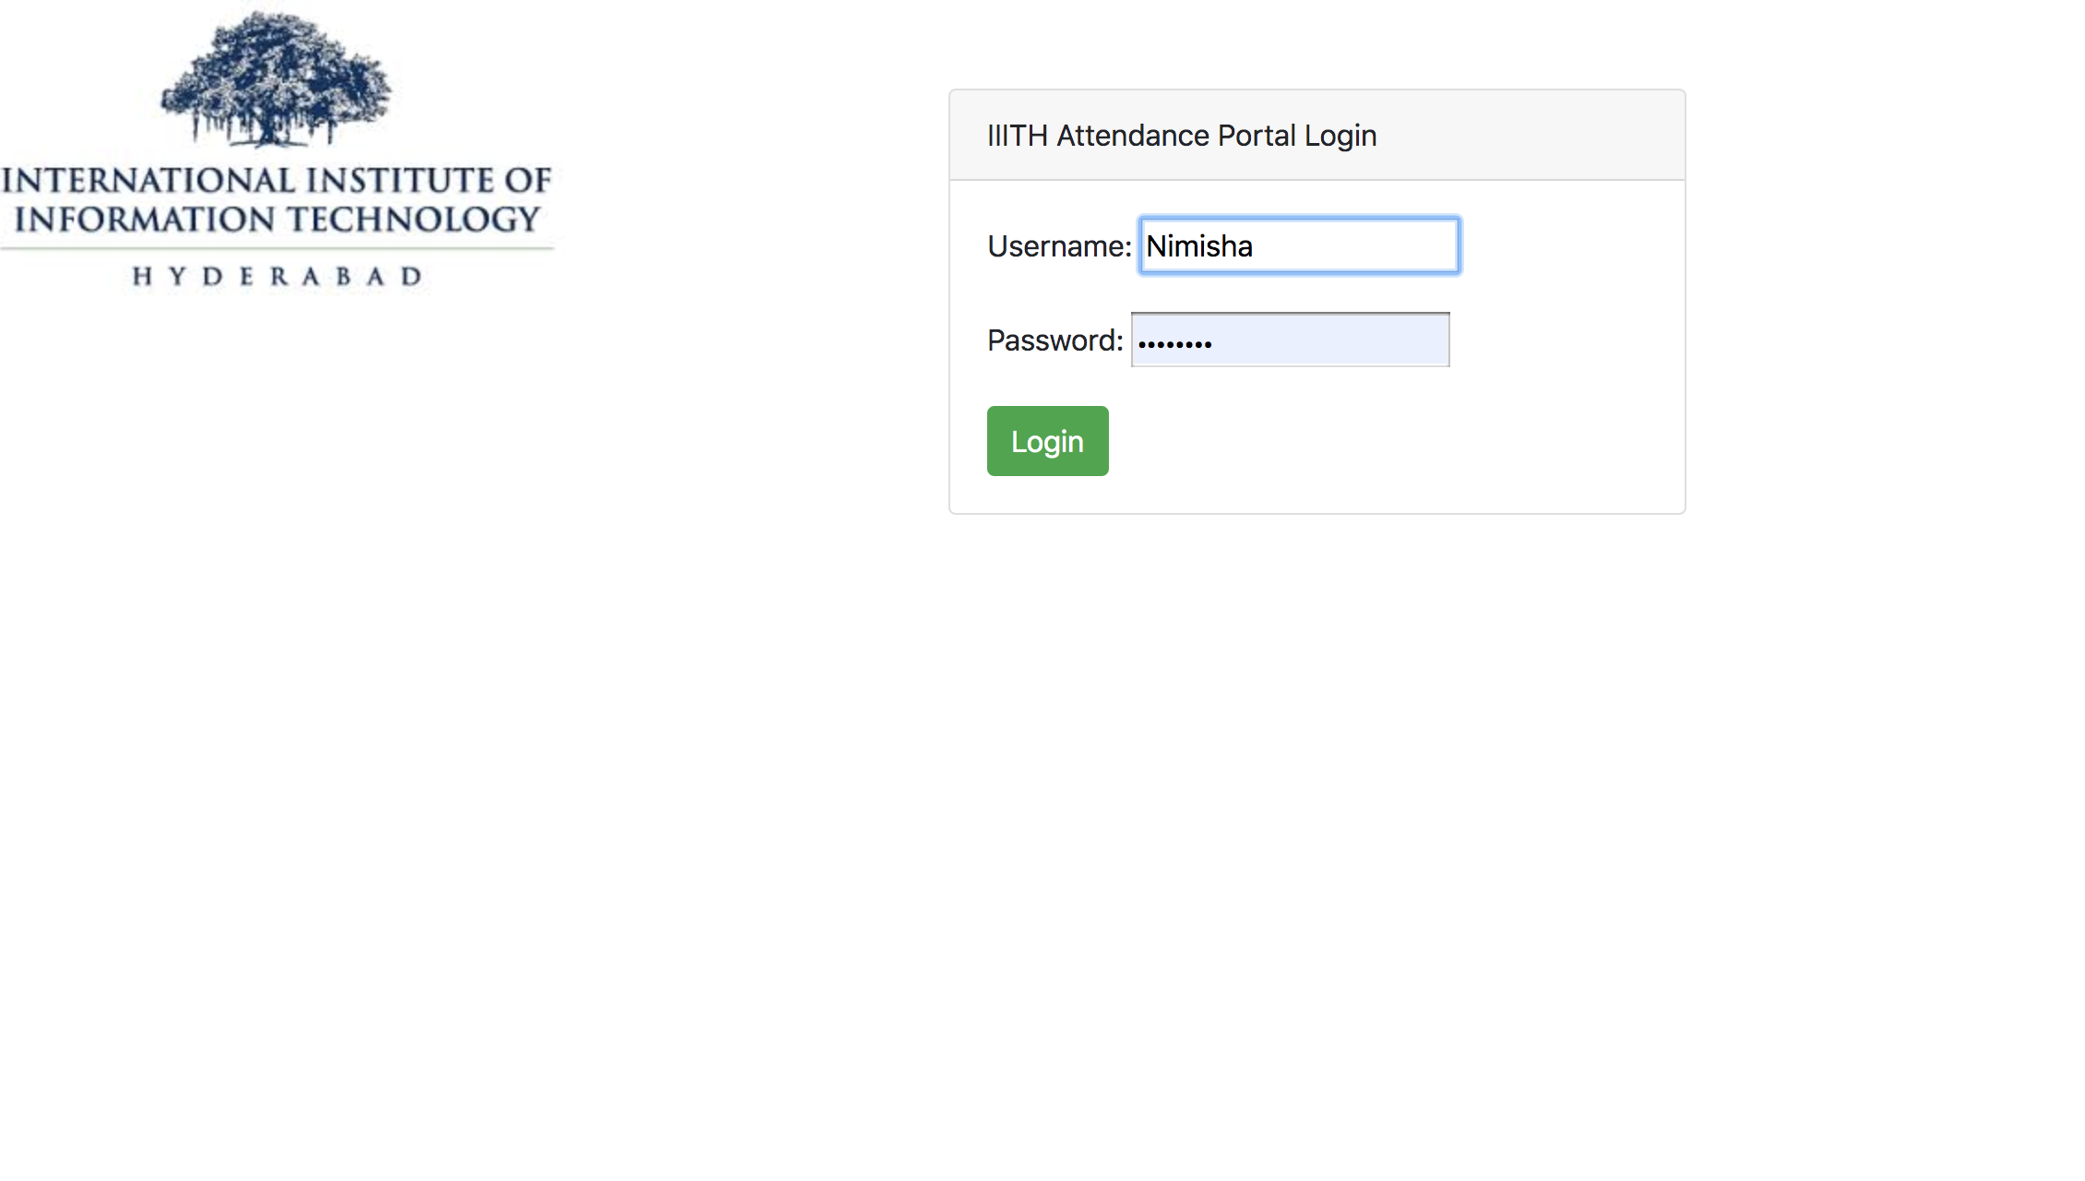
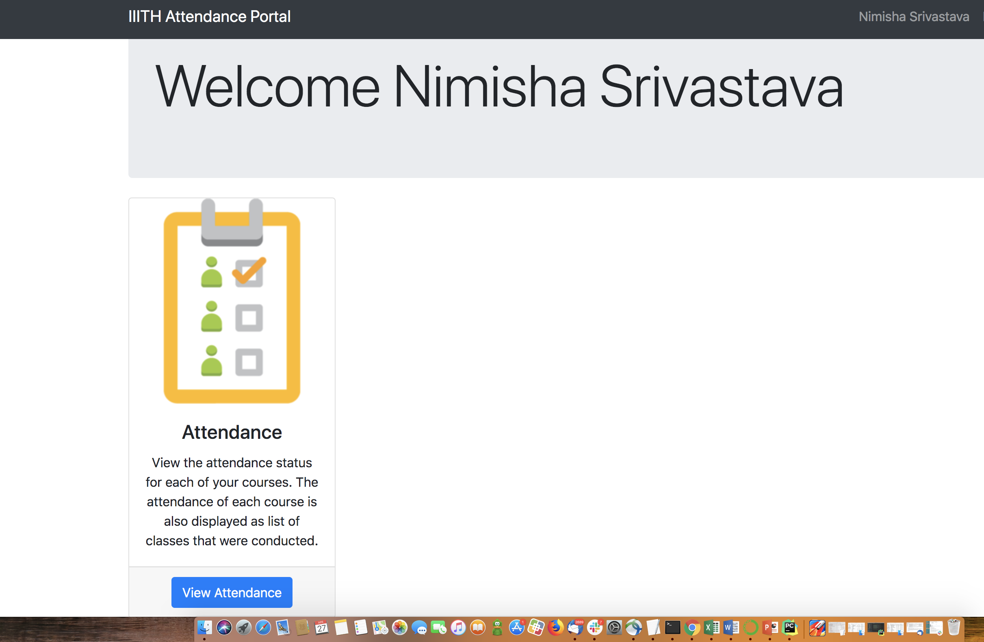
Application details: STUDENT LOGIN

Slide 18
Work Allocation in TEAM
Overall System design and workflow: Nimisha, Pushpa, Gaurav
Face detection API : Pushpa, Nimisha
UI : Ritabrata , Arshad
Models (Database) : Arshad, Sangram, Rama Krishna
Views : Nimisha, Gaurav
Integration : Pushpa
Documentation : Nimisha, Gaurav, Ritabrata
Review and rework of the Code : Arshad, Ritabrata

Slide 19
Scope for IMPROVEMENT - many
Apart from faculty, an Institute admin should be uploading the class photograph
Once the attendance is reported, a notification should go out to all students marked absent, so that they can verify their attendance
Alert and process around Unknown faces recognized by the facial detection system in the picture
The annotated picture sent by the facial recognition API should be persisted in the system for any reference and attendance correction. This can also be shown against each class
System should be made scalable to multiple campuses of an educational institution
Better management dashboard to review statistics and trends for courses
Auto e-mail triggers for attendance approval.
Can invoke the camera from the web portal to capture class images and directly upload in the system
Ability to send multiple pictures and the attendance details returned should exhaustively capture and merge information in the pictures
Student identification by a class video of a predefined time may be a more efficient way to record the attendance.
Can be designed as a microservice to be consumed by already in use systems like Moodle.

